Slide 1

SQL RECAP

Slide 2
THE ELEMENTS OF SQL
Data Squad | SQL introduction

Slide 3
THE ELEMENTS OF SQL
Database
Data Squad | SQL introduction

Slide 4

THE ELEMENTS OF SQL
Database
Table
Data Squad | SQL introduction

Slide 5

THE ELEMENTS OF SQL
Database
Query
Table
Data Squad | SQL introduction

Slide 6
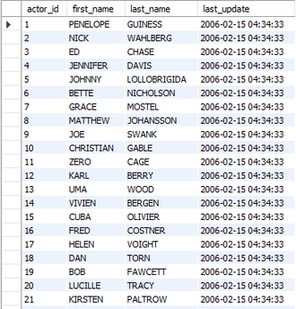
THE ELEMENTS OF SQL
Database
Query
Table
Console
Data Squad | SQL introduction

Slide 7


THE ELEMENTS OF SQL
Database
Query
Table
Console
View
View
Query
Data Squad | SQL introduction

Slide 8
EXAMPLES OF QUERIES
SELECT
GROUP BY
CREATE
FROM
JOIN
UPDATE
WHERE
ON
DROP
Data Squad | SQL introduction

Slide 9
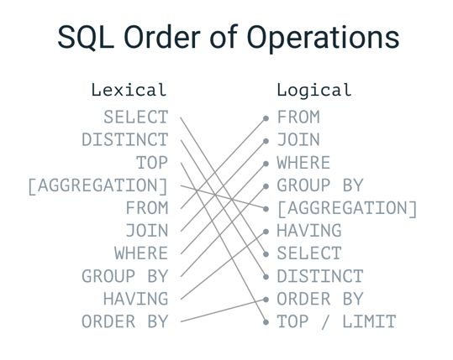
EXAMPLES OF QUERIES
Data Squad | SQL introduction

Slide 10
STRUCTURE OF A QUERY - SELECT
SELECT *
FROM film
SELECT
film_id,
title,
DISTINCT description
FROM film
Data Squad | SQL introduction

Slide 11
STRUCTURE OF A QUERY
SELECT
*
FROM sakila.film INNER JOIN sakila.language
ON sakila.film.language_id = sakila.language.language_id
WHERE film_duration > 80
GROUPBY film_language
HAVING avg_film_rate > 3.2 # used for aggregated fields
ORDERBY & LIMIT/TOP
Data Squad | SQL introduction

Slide 12
STRUCTURE OF A QUERY - SUBQUERIES
SELECT
*
FROM sakila.film INNER JOIN (QUERY 1)
ON sakila.film.language_id = sakila.language.language_id;
WHERE film_duration > 80
GROUPBY film_language
HAVING avg_film_rate > (QUERY 2)
ORDERBY & LIMIT/TOP
Data Squad | SQL introduction

Slide 13
STRUCTURE OF A QUERY - SUBQUERIES
SELECT
*
FROM sakila.film INNER JOIN (QUERY 1)
ON sakila.film.language_id = sakila.language.language_id;
WHERE film_duration > 80
GROUPBY film_language
HAVING avg_film_rate > (SELECT
AVG(film_rate) AS rate
FROM sakila.film;
) # this query returns one value
ORDERBY & LIMIT/TOP
Data Squad | SQL introduction

Slide 14
STRUCTURE OF A QUERY - SUBQUERIES
SELECT
*
FROM sakila.film INNER JOIN (SELECT
DISTINCT Language
FROM sakila.language) as Table1
# this query returns a table
ON sakila.film.language_id = Table1.language_id;
WHERE film_duration > 80
GROUPBY film_language
HAVING avg_film_rate > (QUERY 2)
ORDERBY & LIMIT/TOP
Data Squad | SQL introduction

Slide 15
ACTION QUERIES
CREATE VIEW MyViewName as
QUERY1
CREATE TABLE IF NOT EXISTS labs.students(
student_id INT PRIMARY KEY,
student_name VARCHAR(52),
email VARCHAR(128) DEFAULT 'johndoe@gmail.com',
coolness INT NOT NULL
);
INSERT INTO labs.students
(student_id, student_name, coolness)
VALUES
(7639, "Melissa Badrudin", 10);
UPDATE labs.students
SET email = "melissa.badrudin@ironhack.com"
WHERE
student_id = 7639;
Data Squad | SQL introduction

Slide 16
ACTION QUERIES
CREATE DATABASE database_name;
DROP DATABASE database_name;
DROP TABLE table_name;
Data Squad | SQL introduction

Slide 17
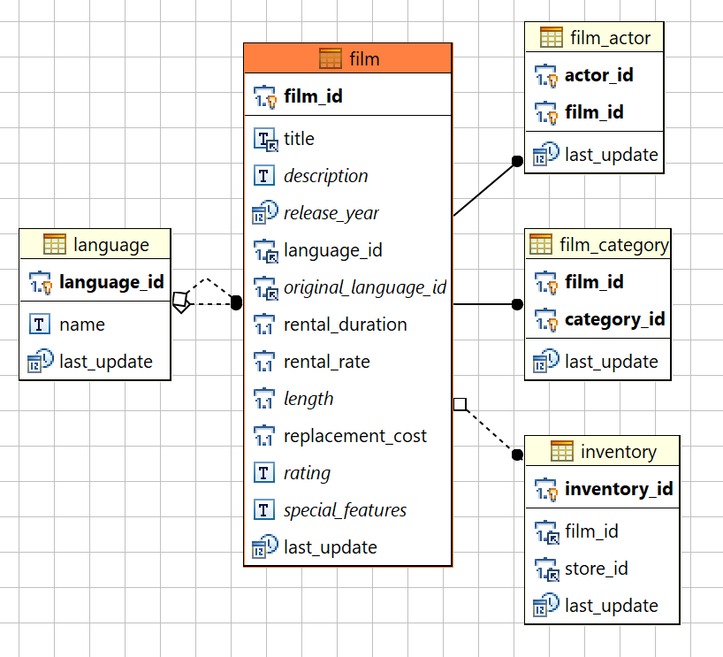
RELATIONAL DATABASE SCHEMA
Entity Relational Diagram (ERD)
Shows content of each table and connections between tables within a database schema
Primay Key and Foreign Key visual here
Data Squad | SQL introduction

Slide 18
ANY QUESTIONS ?

